Slide 1
Air Pollution
Pollution Predictor
Tarun Goyal
Princi Agarwal

Slide 2
Why do we need Pollution-Predictor
Today pollution is increases day by day . One of the most important emerging environmental issues in Asian cities is air pollution . Everybody should save themselves from air pollution . So here we have made a website on which you can go and predict about the air pollution occurring per day , in any month , in any year . So that before leaving home you can predict whether you should go outside or not by keeping your health in your mind . In this manner we can increases our some quality life.

Slide 3
Delhi Air-Pollution
The air quality in Delhi and National Capital Region (NCR) is one of the worst in the world, as per a WHO survey of 1600 world cities. Two other cities in India that have worse air quality than Delhi includes - Gwalior in Madhya Pradesh, and Raipur in Chhattisgarh. Air pollution in India is the fifth largest killer and it is estimated to kill 1.5 million people every year. In Delhi, poor quality air damages irreversibly the lungs of 2.2 million or 50 percent of all children. In November 2016, in an event known as the Great smog of Delhi, the air pollution spiked far beyond acceptable levels. Levels of PM2.5 and PM 10 particulate matter hit 999 micrograms per cubic meter, while the safe limits for those pollutants are 60 and 100 respectively.

Slide 4
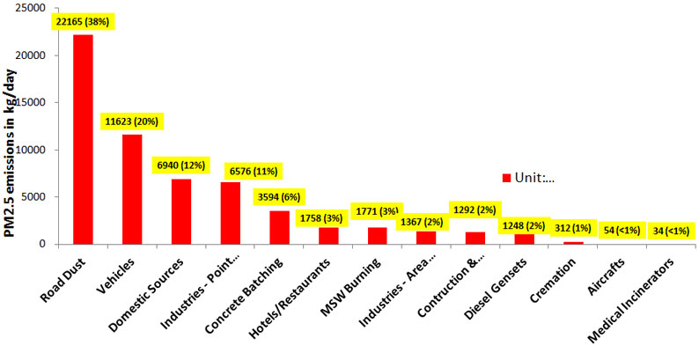
Graph representing pollution caused by PM2.5 by many sources per day in kg.

Slide 5
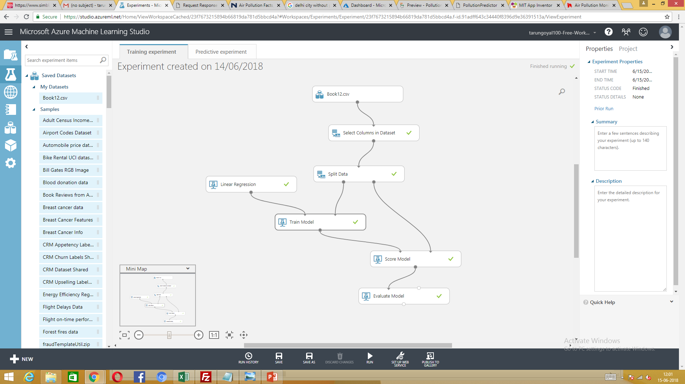
Steps of Experiment
1.

Slide 6
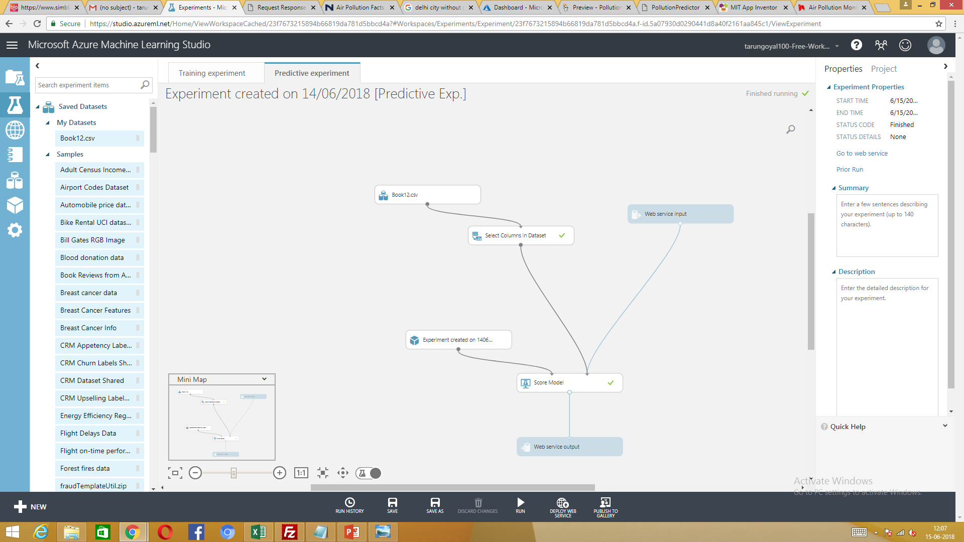

Slide 7
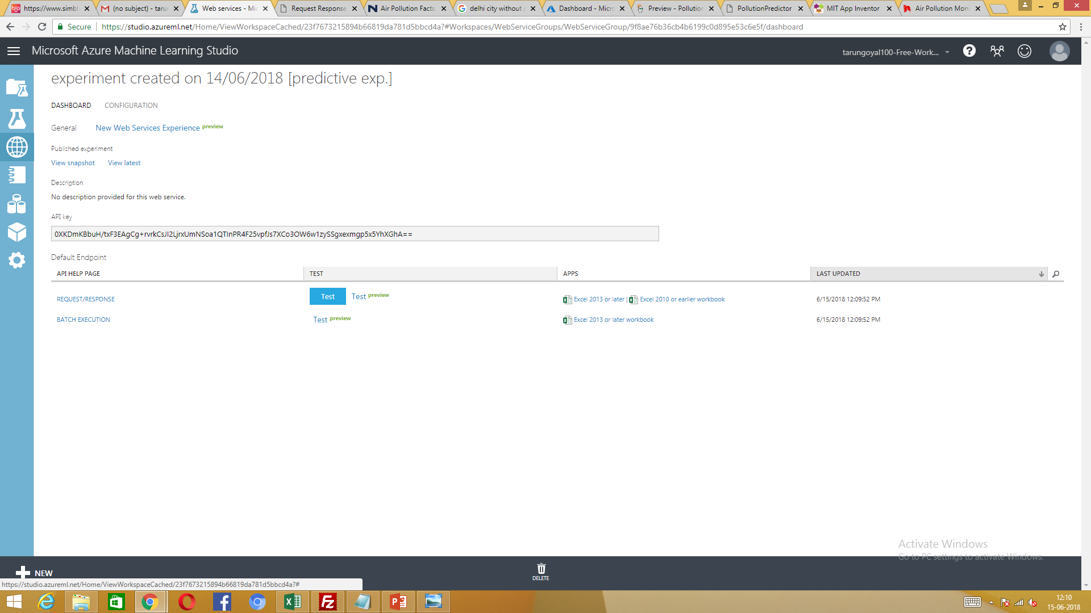

Slide 8
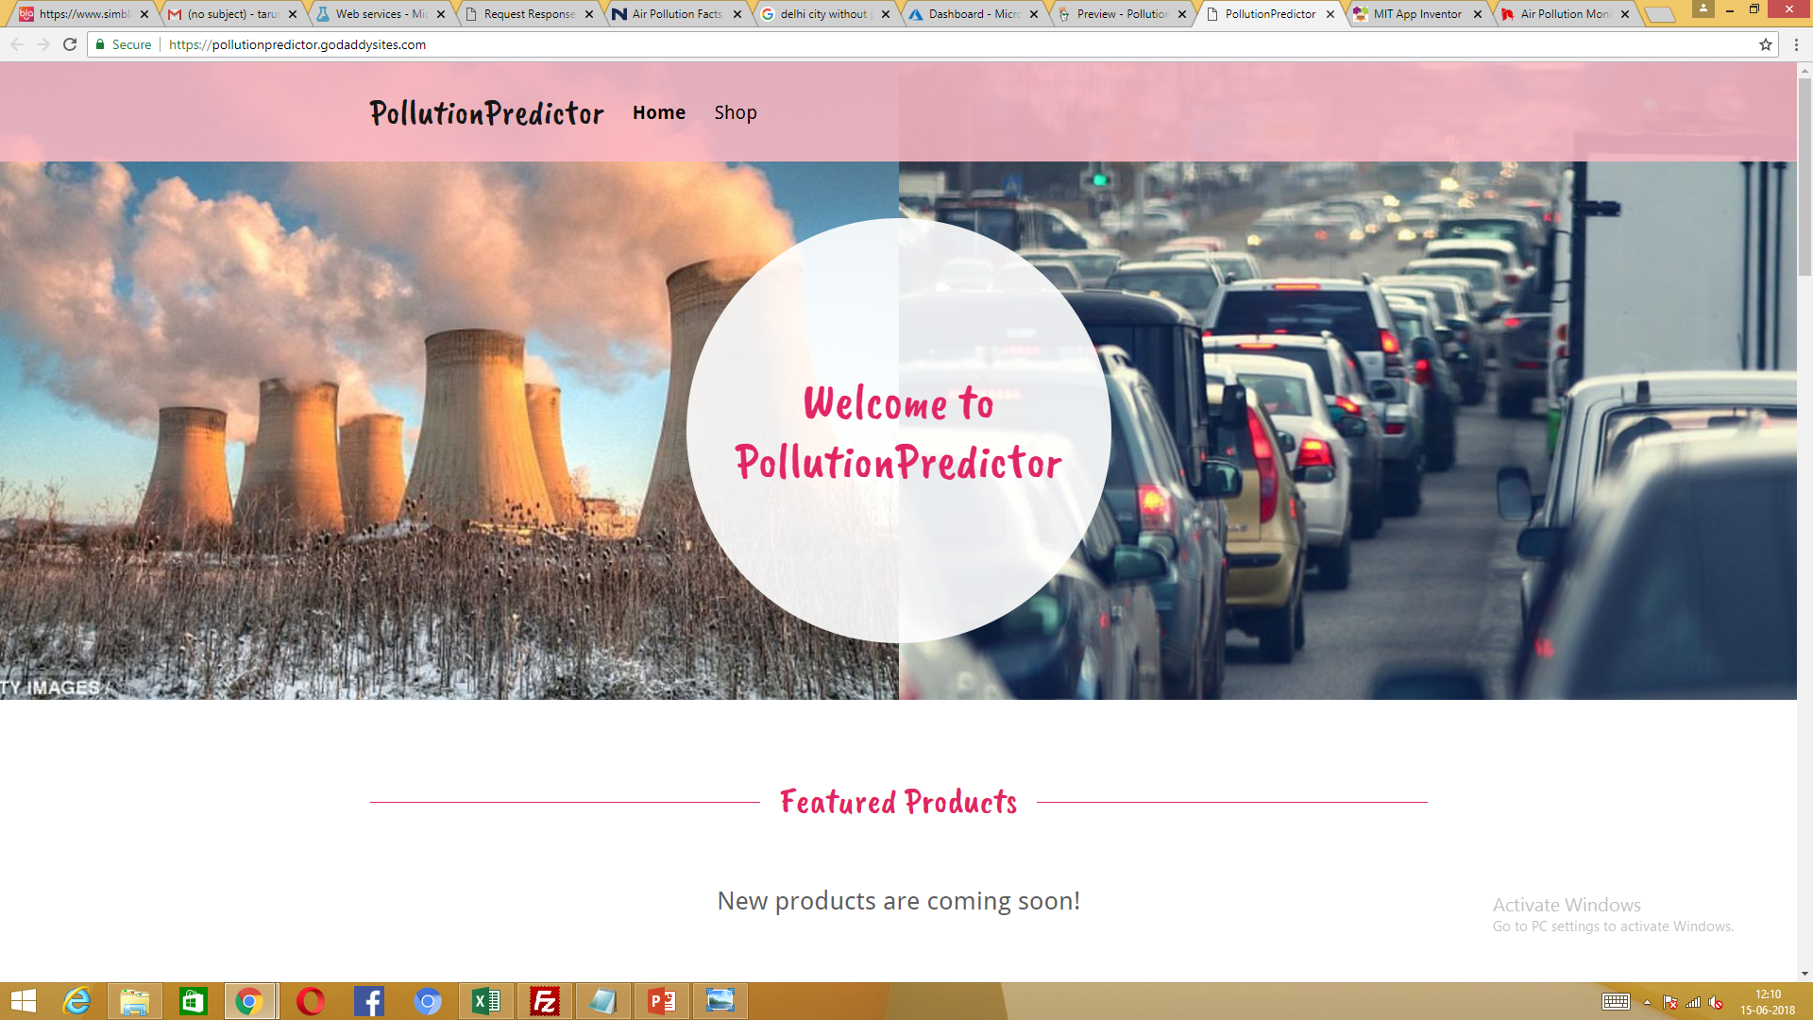

Slide 9
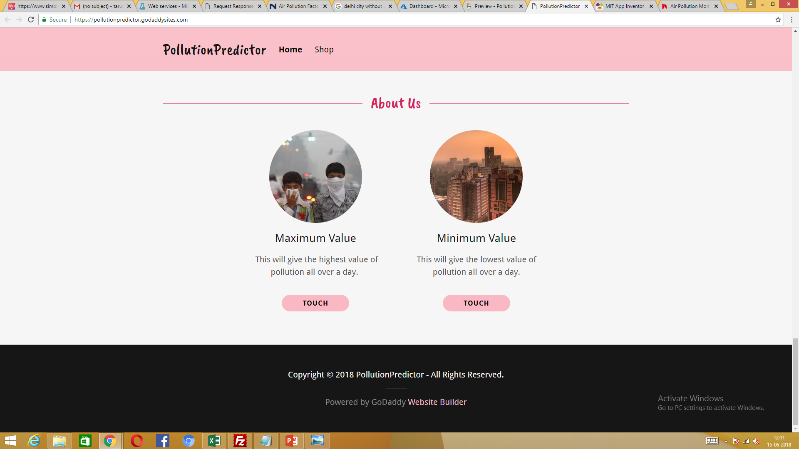

Slide 10
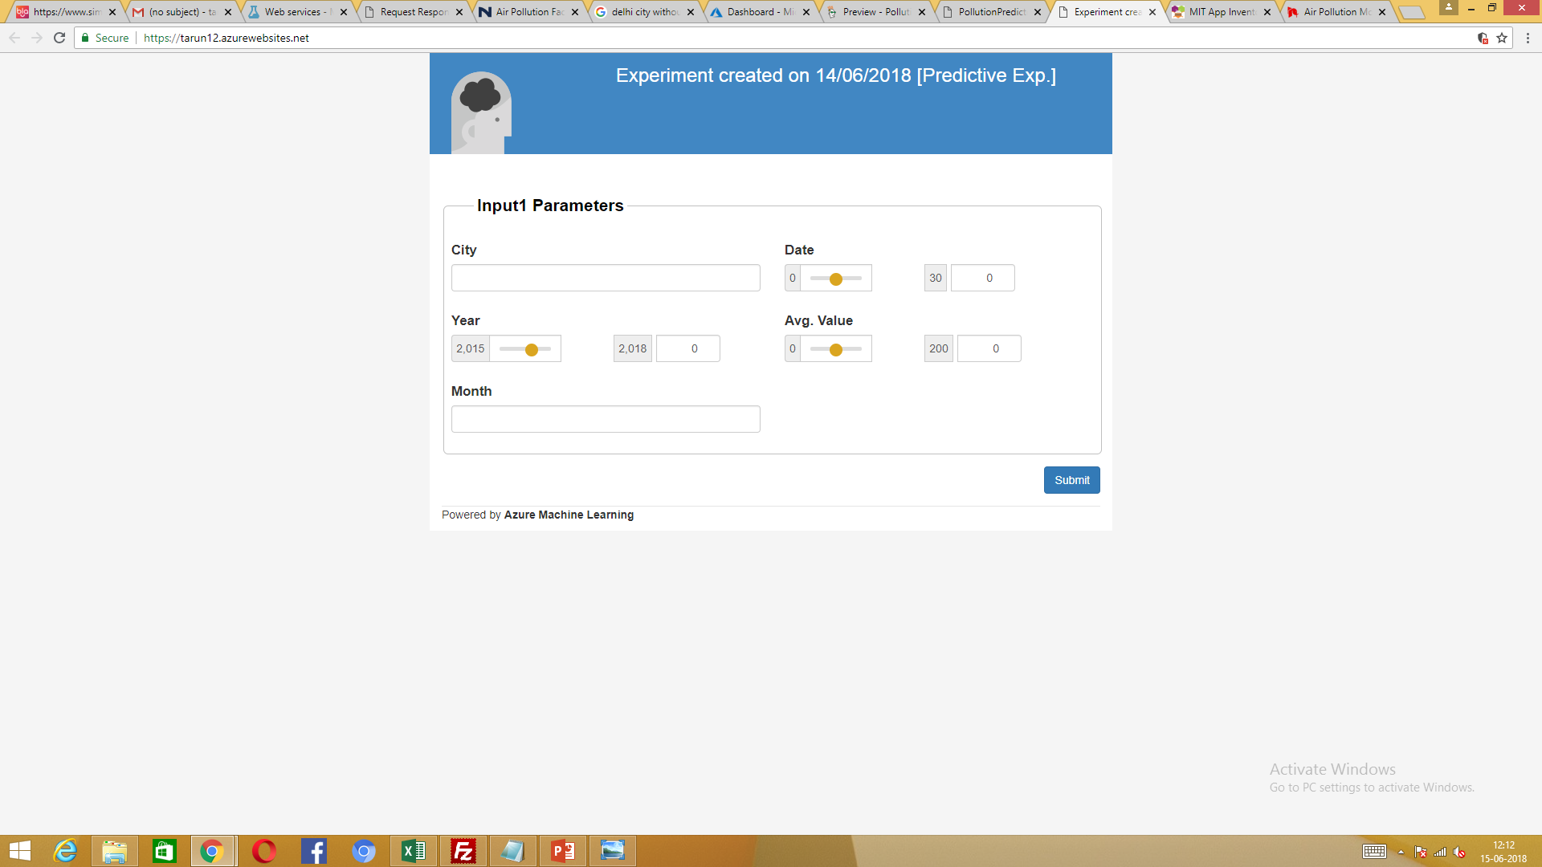

Slide 11


